Slide 1


Final presentation
ACE car team presents

Slide 2
Plan
Introduction
Organization part
Technical design parts
Mechanical design
Electronical design
Hardware design (Electronics)
Software design
Documentation part

Slide 3
Project plan
Project Goals
Objectives
Organization of work
Risks
Resources

Slide 4
Gantt Chart
TASK | ASSIGNED TO | PROGRESS | START | END
Requirement analysis |  | 100% | 2/11/22 | 2/18/22
Team collaboration | All team | 100% | 11/2/22 | 13/2/22
Workload planinig | All team | 100% | 12/2/22 | 14/2/22
MoSCoW method | All team | 100% | 13/2/22 | 17/2/22
Project plan | All team | 100% | 13/2/22 | 18/2/22
Reporting | All team | 100% | 20/2/22 | 20/2/22
High level design |  | 100%
Integration tests | Tarik M. | 100% | 23/2/22 | 26/2/22
Architecture | Miguel P. | 100% | 23/2/22 | 27/2/22
Requirement and technology | Karolis J. | 100% | 24/2/22 | 1/3/22
Basic design | Jurijs Z., Dmytro T. | 100% | 25/2/22 | 3/3/22
Reporting | All team | 100% | 6/3/22 | 8/3/22
Detailed design |  | 100%
Detailed specifications | Jurijs Z.,Miguel P. | 100% | 12/3/22 | 16/3/22
Low level flowchart | Dmytro T. | 100% | 14/3/22 | 18/3/22
Hardware design | Karolis J. | 100% | 15/3/22 | 20/3/22
Unit test plan | Tarik M. | 100% | 17/3/22 | 22/3/22
Reporting | All team | 100% | 22/3/22 | 23/3/22
Implementation |  | 100%
Actual coding | Dmytro T., Jurijs Z. | 100% | 25/3/22 | 27/3/22
Module assembling | Miguel P. | 100% | 27/3/22 | 29/3/22
Building PCB | Karolis J., Tarik M. | 100% | 29/3/22 | 2/4/22
Component preparation | Miguel P. | 100% | 31/3/22 | 5/4/22
Reporting | All team | 100% | 6/4/22 | 8/4/22
Unit testing |  | 100%
Inverse testing | Tarik M., Miguel P. | 100% | 10/4/22 | 13/4/22
Debugging | Jurijs Z., Dmytro T. | 100% | 10/4/22 | 12/4/22
Performing unit testing | Karolis J., Tarik M. | 100% | 11/4/22 | 15/4/22
Reporting | All team | 100% | 16/4/22 | 17/4/22
Integration testing |  | 100%
System function testing | Jurijs Z., Dmytro T. | 100% | 19/4/22 | 21/4/22
Component testing | Karolis J., Tarik M., Miguel P | 100% | 20/4/22 | 24/4/22
Team report | All team | 100% | 25/4/22 | 27/4/22
System testing |  | 100%
Performance testing | All team | 100% | 7/5/22 | 17/5/22
Regression testing | All team | 100% | 17/5/22 | 19/5/22
Acceptance testing | All team | 100% | 17/5/22 | 21/5/22
Main system report | All team | 100% | 21/5/22 | 26/5/22

Slide 5
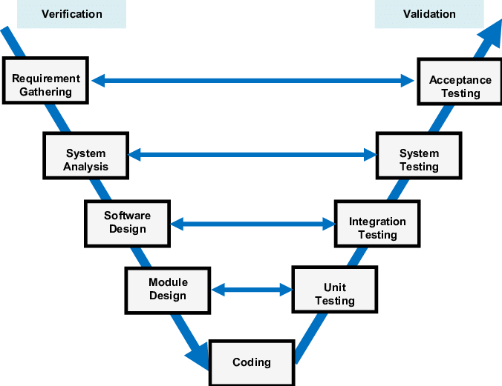
Project Methods

Slide 6
Documentation
Create documents
Maintainan and update documents
Share, review and approve documents
Save documentation

Slide 7


Documents
Project plan
Functional design
Technical design
Order List
Mid-Term Presentation
Final report
Final Presentation
Logbooks
https://github.com/karolis1115/ACEcar - ACEcar GitHub project repository.

Slide 8

Technical Design
Mechanical design
Electronical design
Hardware design (Electronics)
Software design

Slide 9
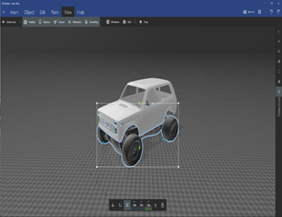
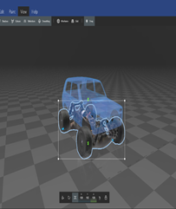
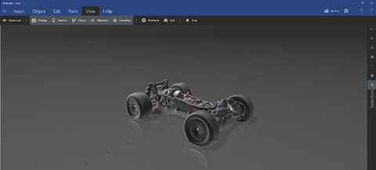
Mechanical design

Slide 10
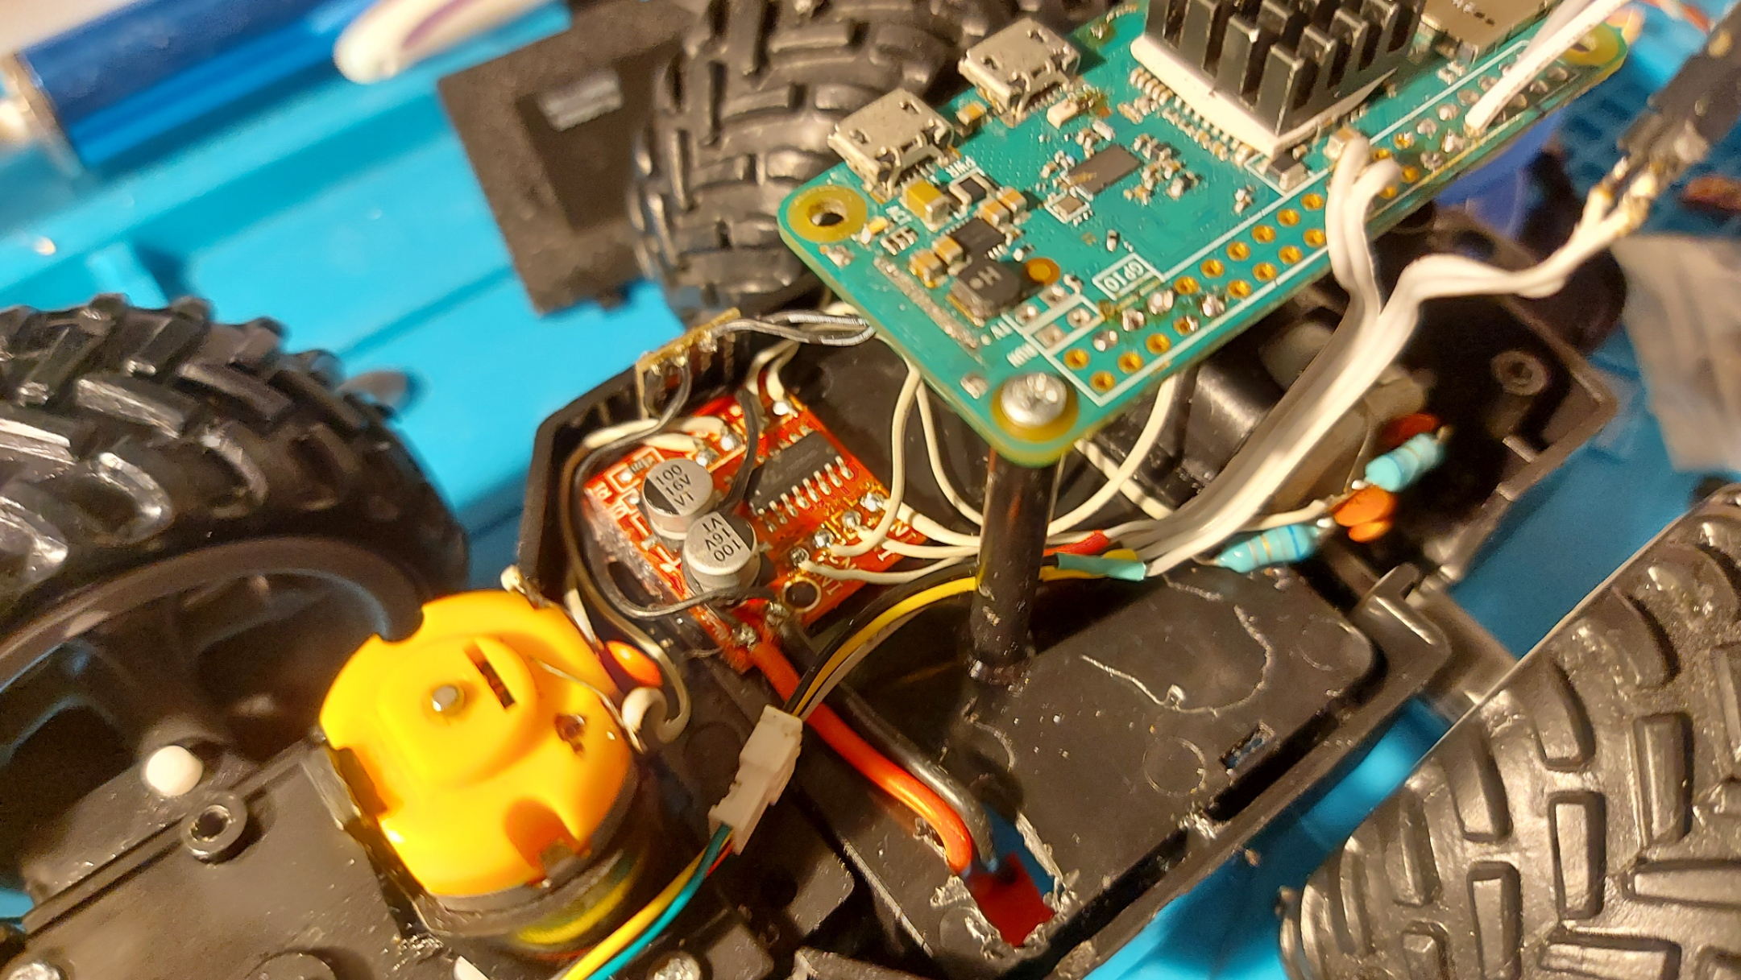
Electrical design

Slide 11
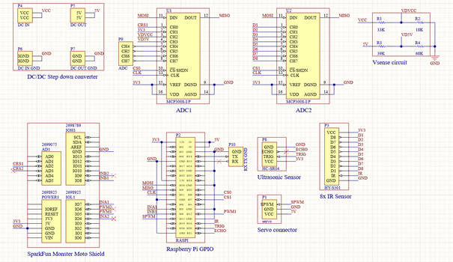
Schematics

Slide 12
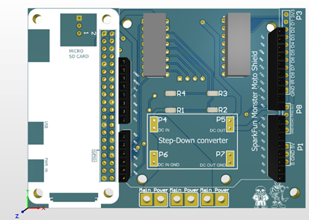
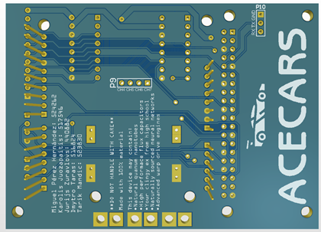
Printed Circuit board model

Slide 13
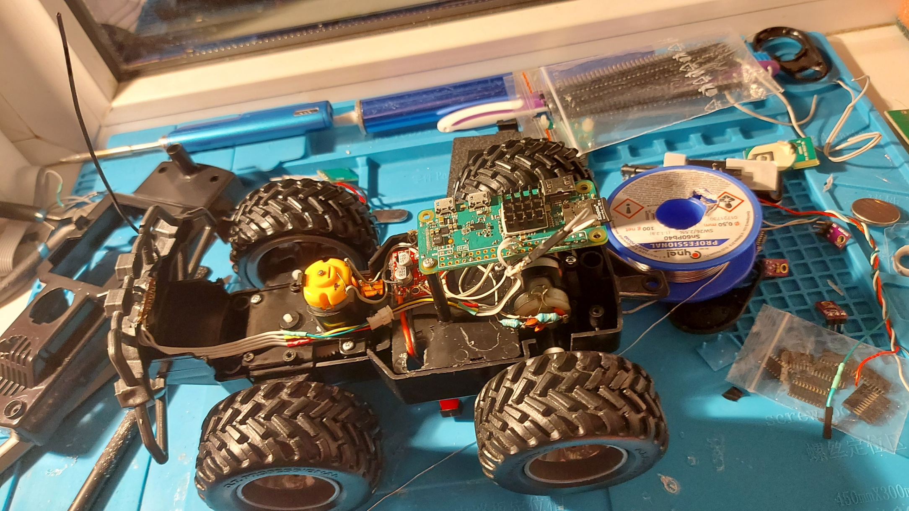
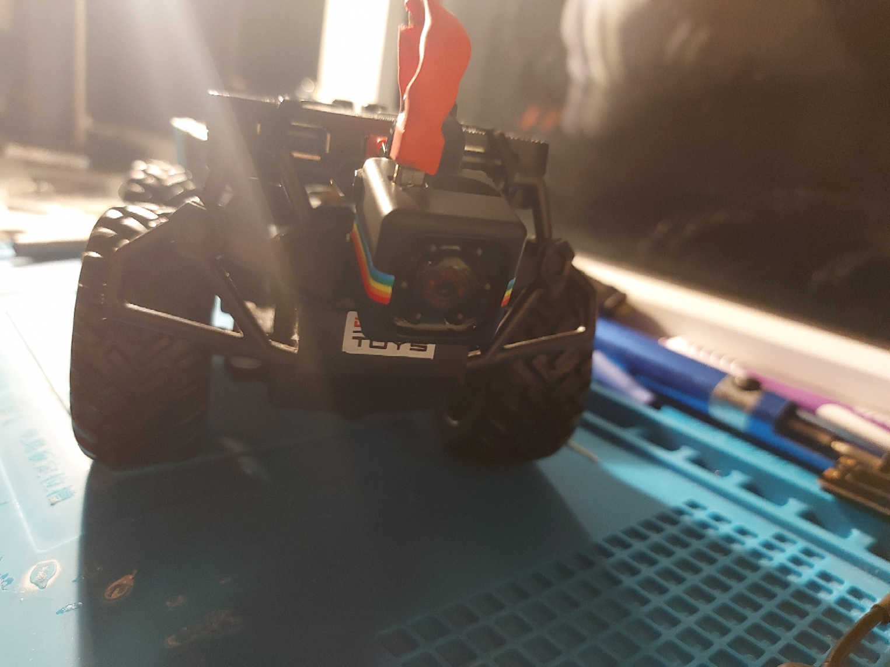
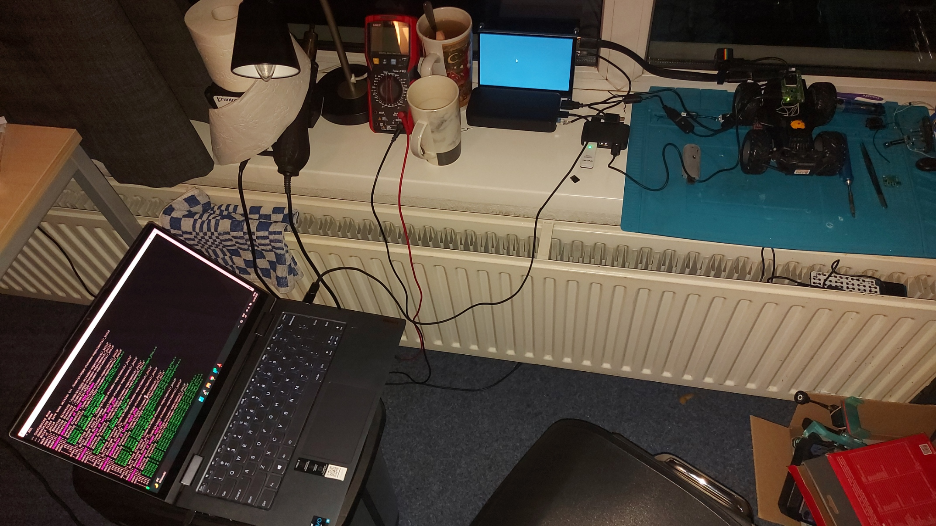
Making of the prototype

Slide 14
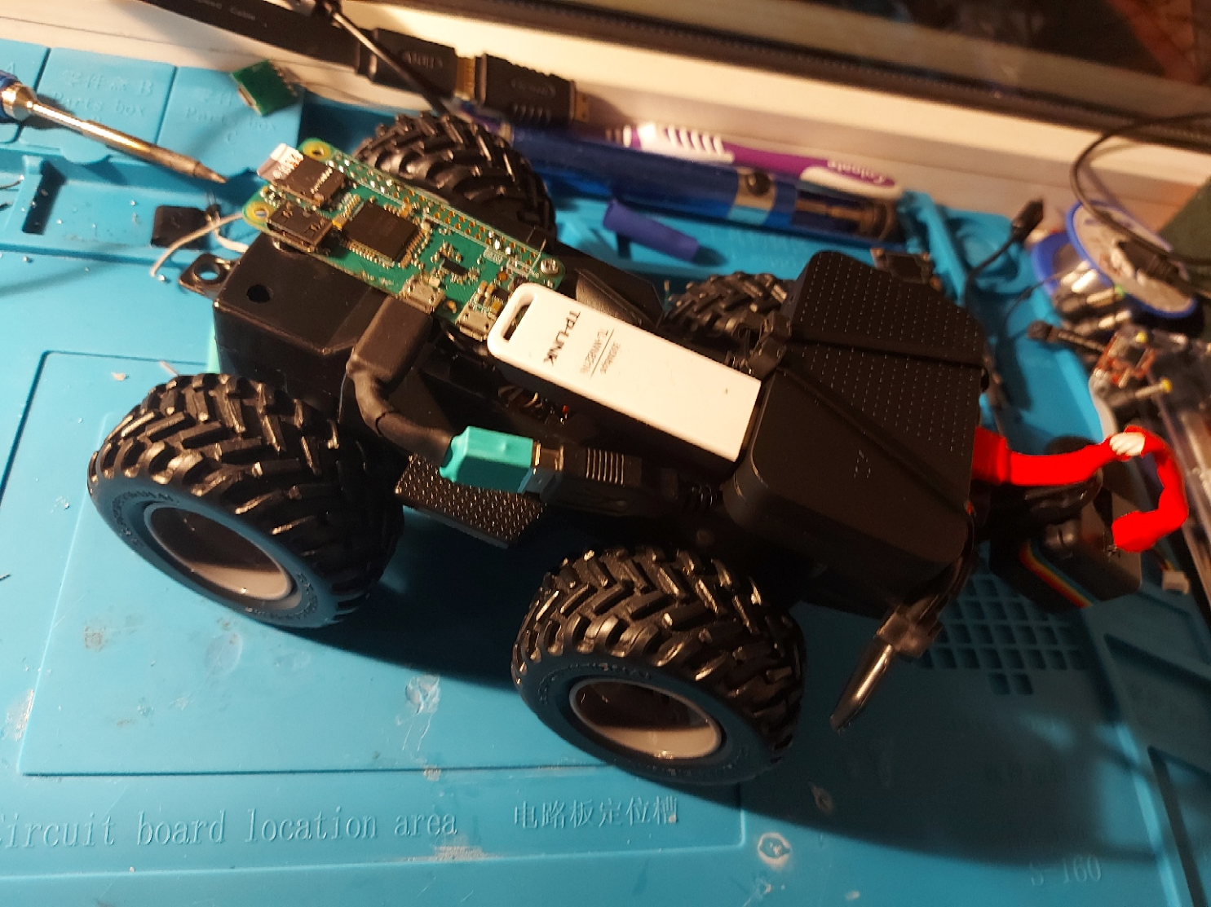
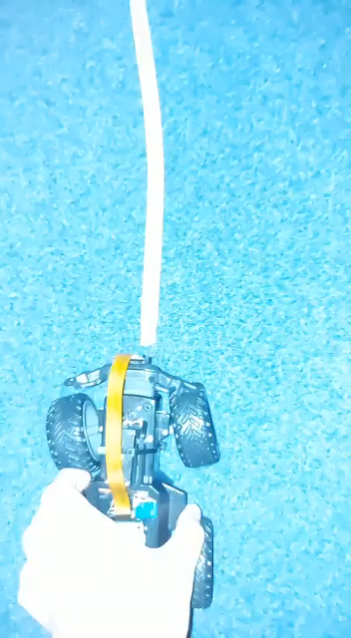
Prototype First demo

Slide 15
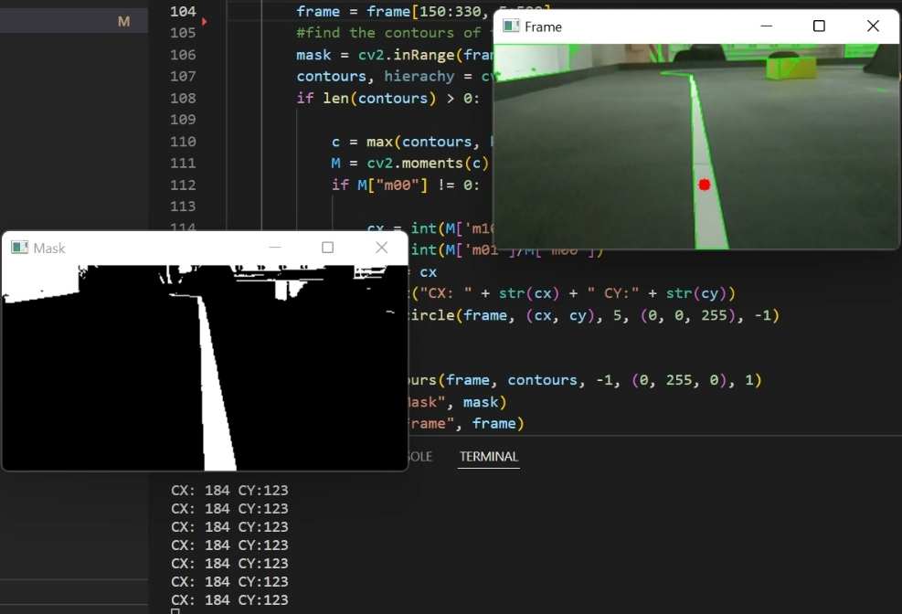
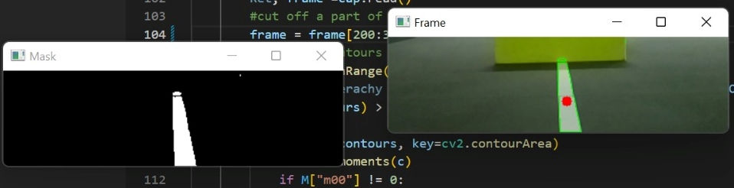
Software Design
Python
Numpy library
Cv2 library
Visual Studio Code
OpenCV
Finding
Warping
Finding curve
Optimization

Slide 16
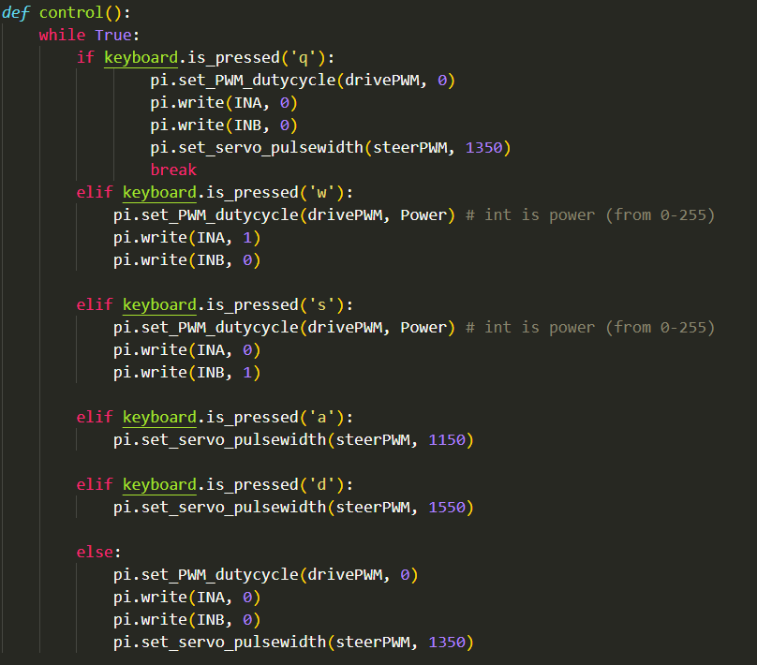
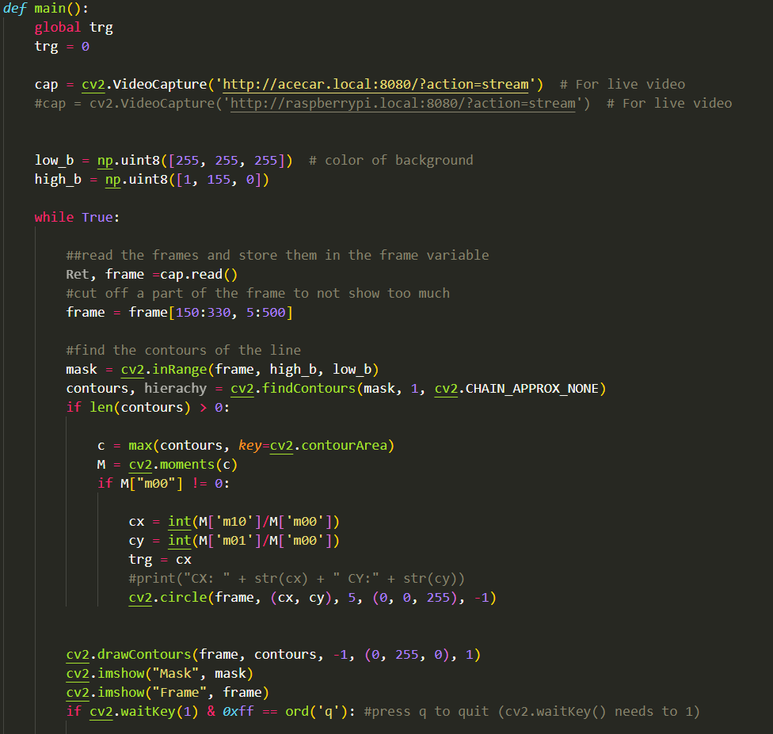
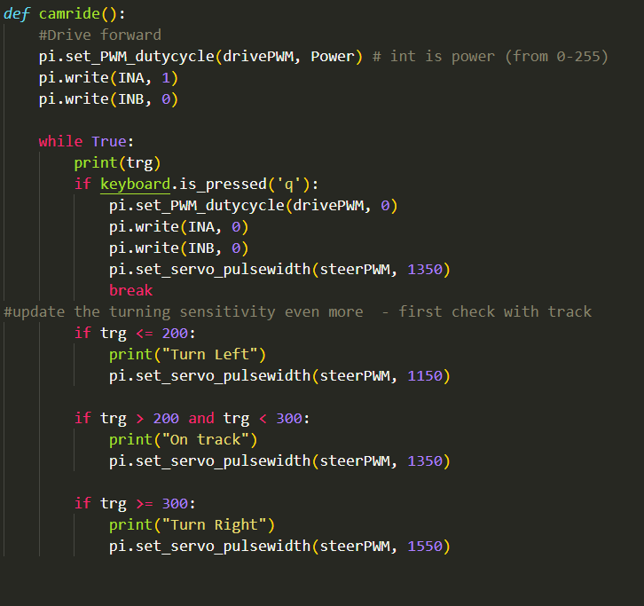
Motion on track PLUS print the result into console
Control from computer​
Live Video capture

Slide 17
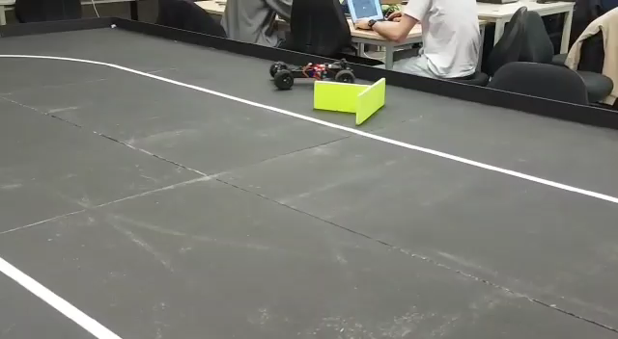
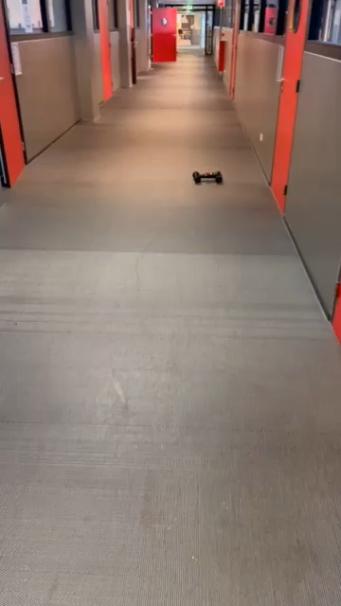
Some our test video

Slide 18
Thanks for your attention!

